Slide 1

Best Practices in New Volunteer “On-boarding” and Orientation
Art Drake
October 20, 2006 : 1:30 P.M.
Executive_Chair@pmosig.org

Slide 2
Core Knowledge Area and
Competency
Association Governance
  Volunteer Management
    Resource management
    Team building
    Achieving organizational goals
    Managing balance

Slide 3
Sessions Objectives
Getting the right people into the right volunteer opportunities
The role of volunteer management in introducing and enabling new volunteers to quickly begin working effectively within the organization
Best practices in “on-boarding” new volunteers, making them “feel at home”, introducing them to the organization and their roles, and encouraging them to excel
Collaborative discussion around developing a new volunteer “on-boarding kit”

Slide 4


A Typical “Day in the Life”
Members
Other Volunteers
PMI
Completed Work
Other Components
Problems,Calls
Projects
“LIFO”

Slide 5
Planning and Execution
Business Management
  Establishing organizational strategies/goals
  Determining best approach to achieving these goals
    Projects, collaboration, build/buy, business partners
  Identifying constraints
  Budget allocation
  Getting resources (a.k.a. “volunteers”)

Slide 6
Now What?
Now that you have a volunteer matched with an open position, what’s next? How do you quickly:
  Bring the volunteer up to speed on their role and responsibilities
  Make him/her part of the team
  Provide support for the new team member

Slide 7
Volunteer Management
Framework
Plan
Recruit
Engage
Transition
Orientation
Introduction
Performance
Feedback
Thoughts
  Volunteers are a limited resource
  You’re a volunteer

Slide 8
On-boarding Steps
  Plan: Determining The Right Need
  Recruit: Finding The Right Fit
  Engage:
    New volunteer orientation & introduction
    Performance management & development
    Continuous support
    Recognition
  Transition:
    Retention
    Advancement
  Logistics

Slide 9

Plan: Resource Planning
Define The Position
  Identifying the need(s)
    What, where, why, when, how…
  Clarifying and setting appropriate expectations
  Taking the person into consideration – balance
  Success criteria
  “Job Description”

Slide 10
Recruit: Finding The Right Fit
Know What To Look For
  Post open positions
  Collect to resumes
  Interview
Oversight
  Manage submissions
  Board concurrence
  Notification

Slide 11
Engage: New Volunteer Orientation
The process through which the SIG and the Volunteer “get on the same page”
  Reiterate the goals/responsibilities of the position (has anything changed?)
  Clarifying and setting appropriate expectations
  Understanding the personal/professional goals of the Volunteer
  Getting the Volunteer “plugged in”

Slide 12

Engage: New Volunteer Orientation
Understand The Volunteer
  Expectations of the volunteer
  Understanding/establishing goals –personal and/or professional
  Determine the necessary support
  Required training / mentoring
  Communication

Slide 13

Engage: Introduce
Establish the new volunteer
Clarify the volunteer’s role with the other Board/team members
Communicate the volunteer’s authority
Look for disconnects/constraints

Slide 14

Engage: Performance
The Business Plan
  SIG activities as they relate to…; Provide context
  Execution aligned with corporate/SIG goals
  Volunteers need to understand how they contribute
  BSC vs. KPIs – “…what gets measured gets managed…”

Slide 15
Engage: Performance
Tour of operational procedures, rules & governance
  Provide policies/procedures to volunteers so they don’t have to guess (e.g., budget submission/approval, expense reimbursements, code of conduct, etc.)
  Spend more time on execution, less on explanation

Slide 16
Engage: Performance
Membership overview and communications
  Understanding the SIG’s customers and constituents
  Volunteers bring a perspective to the overall SIG operation/discussion – member, employer, etc.
  Ensure volunteers can reach and communicate with the necessary constituents

Slide 17
Engage: Feedback
Communication
  Never too much communication
Measurement/contribution to the strategic goals
Balance
  Scheduled time
  A feeling of obligation vs.
  commitment

Slide 18

Transition: What’s Next?
Completion ➔ Next Opportunity
Recognition
Review Volunteer’s Goals
Retention and Advancement

Slide 19

Logistics
Make sure the volunteer has what they need to perform and fulfill their responsibility
  Access to email, systems, data, etc.
Communicate with members and other constituents
Volunteer needs to identify constraints

Slide 20
Managing Risk
Learning Curve
  Have we asked the volunteer to take on a role/responsibility that they are not prepared for?
Level of commitment(s)
Isolation
  The word should be “collaboration”
Pay Increases
  Make sure your volunteers are appreciated
  Confirmation – celebrate success

Slide 21
Organizational Health
Transition Planning
  A more disciplined approach to managing volunteers facilitates the SIG’s transition
  Succession planning
Performance
  Successful execution – strategy, objectives, projects
  Volunteers create member value – are you cultivating valued volunteers?

Slide 22
Volunteer Retention
Planning For Success
  A volunteer that feels valued/appreciated is more likely to “sign up” for another project
  Volunteers find other volunteers
  Facilitate transition
  Opportunities for advancement
  An avenue to achieve personal/professional goals

Slide 23
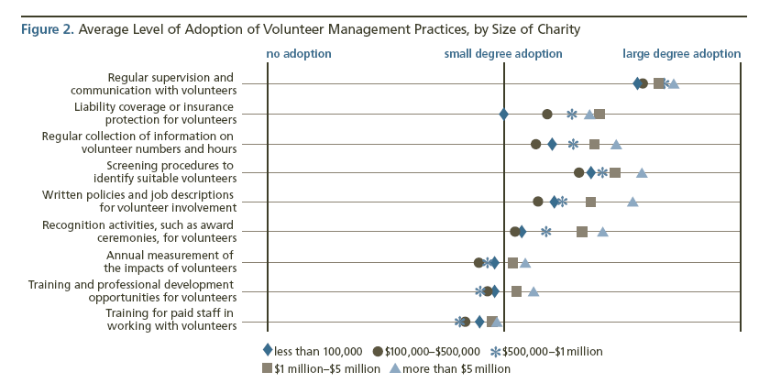
What Others Are Saying

Slide 24
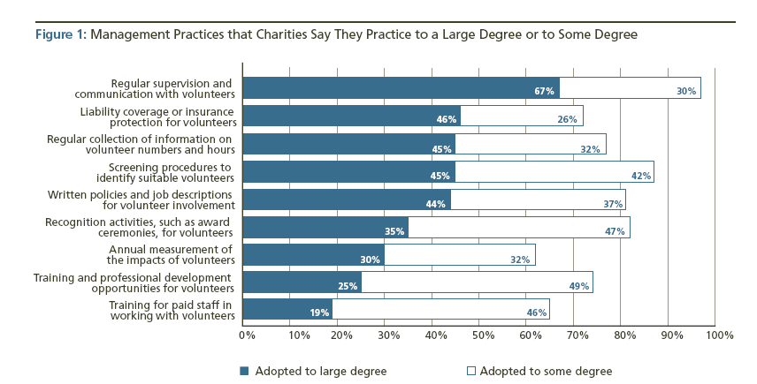
What Others Are Saying
A Study on volunteerism conducted by the Urban Group 2004
http://www.urbaninstitute.org/UploadedPDF/411005_VolunteerManagement.pdf

Slide 25
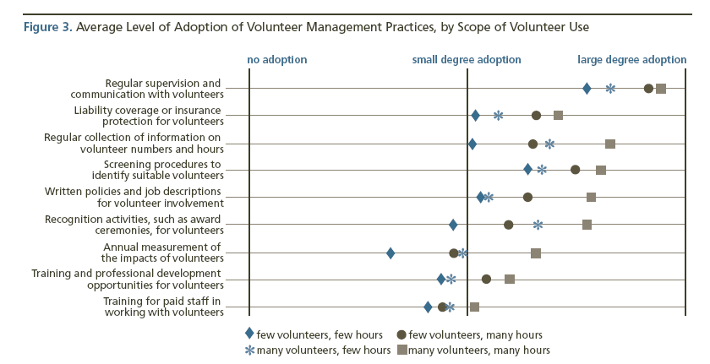
What Others Are Saying

Slide 26
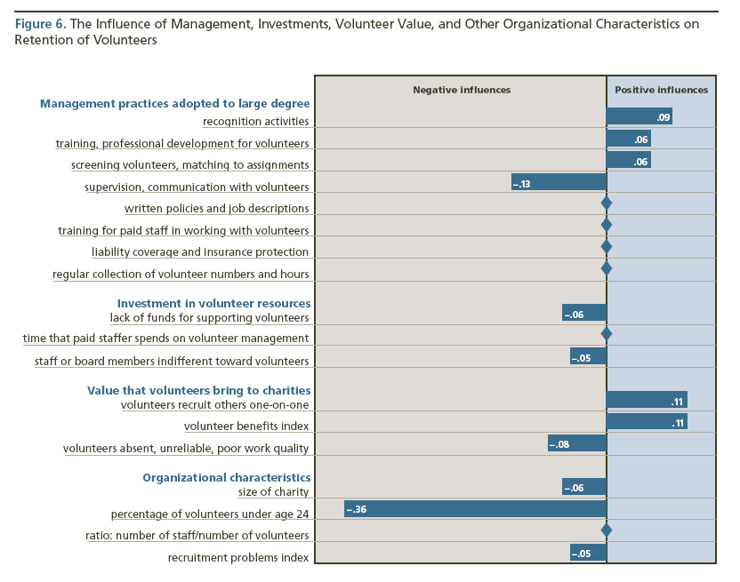
Other Resources

Slide 27
On-boarding Kit
Clear expectations (job description)
Business plan (provides context/direction)
Formal policies/procedures (how-tos)
Formal introduction (conveyance)
Feedback & recognition (what’s in it for …)
What’s next (achieving goals)
Communication!

Slide 28
Other Resources
http://www.energizeinc.com
http://www.casanet.org
http://www.urban.org
http://www.serviceleader.org

Slide 29
Questions?
Thank you!

